Slide 1
Module 2. Unsupervised learning: distances and clustering
Philip Moos and Jeff Chang

Slide 2
Outline
What is unsupervised learning or clustering?
Distance metrics.
Clustering Algorithms.
k-Means clustering.
Hierarchical Clustering.
Principal Components Analysis
t-SNE

Slide 3
Objectives
To understand why and when to use clustering.
To be able to select a proper distance metric based on the characteristics of the data.
To be able to compare and contrast popular algorithms for clustering.

Slide 4
Does anyone have an idea what we mean when we say: supervised and unsupervised learning?

Slide 5
What is Unsupervised Learning?
Unsupervised learning (i.e. clustering) is used to explore the data, and reveal the strongest patterns within the data in an unbiased manner.
In unsupervised learning, an expectation is that all of the necessary information is within the data and that an appropriate algorithm will cluster the data in an interpretable and meaningful manner leading to the discovery of underlying structure.
In unsupervised learning, for each learning task, the expected (or desired) output is not available. Hence, the algorithm has to learn a mapping and estimate the output by itself (without supervision).

Slide 6
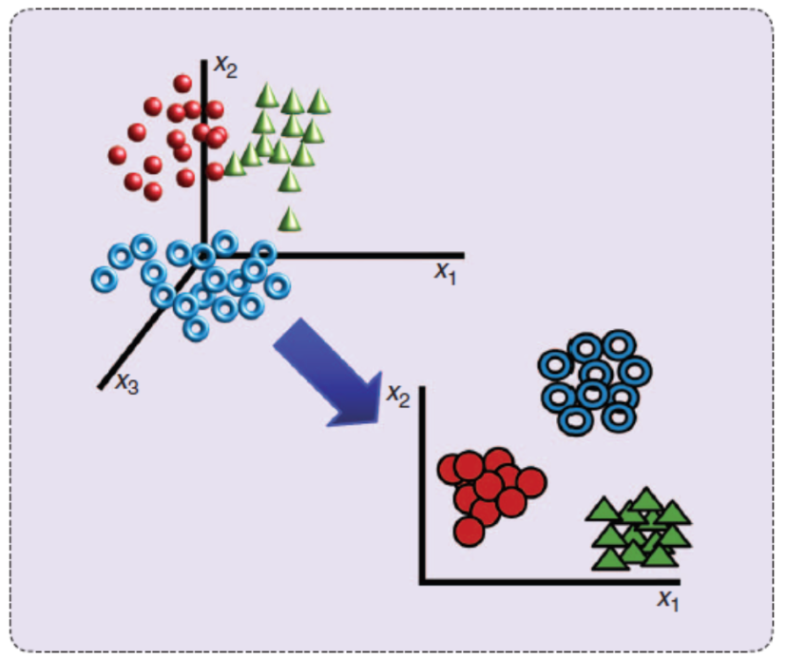
Searching for groups
Clustering is unsupervised or undirected.
Unlike classification, in clustering, no pre-classified data.
Search for groups or clusters of data points (records) that are similar to one another.
Similar points may mean: similar regulation of genes, similar phenotypes, that will behave in similar ways.
Group points into classes using some distance measures.
Within-cluster distance, and between cluster distance
Applications:
As a stand-alone tool to get insight into data distribution
As a preprocessing step for other algorithms

Slide 7
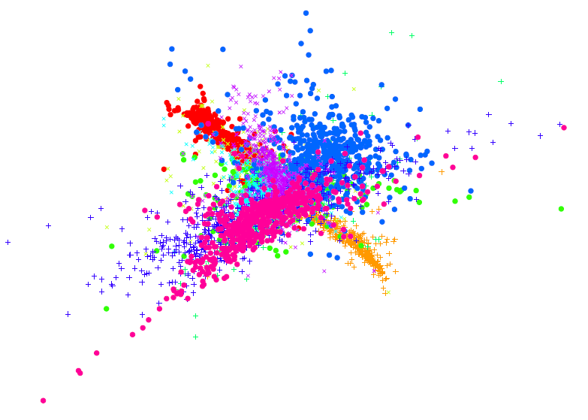
What is good clustering?
A good clustering method will produce high quality clusters with
high intra-class similarity
low inter-class similarity
The quality of a clustering result depends on
the similarity measure used
implementation of the similarity measure
The quality of a clustering method is also measured by its ability to discover some or all of the hidden patterns

Slide 8
Desired features of clustering in data mining
Scalability
Ability to deal with different types of attributes
Discovery of clusters with arbitrary shape
Minimal requirements for domain knowledge to determine input parameters
Ability to deal with noise and outliers
Insensitivity to order of input records
High dimensionality
Incorporation of user-specified constraints
Interpretability and usability

Slide 9
Similarity and dissimilarity between objects
There is no single definition of similarity or dissimilarity between data objects
Similarity/dissimilarity between objects is often expressed in terms of a distance measure d(x,y)
Ideally, every distance measure should be a metric, i.e., it should satisfy the following conditions:
Notes:
Complications:
Interval-scaled variables
Binary variables
Nominal, ordinal, and ratio variables
Variables of mixed types
Complex data types

Slide 10
Distance on Numeric Data: Minkowski Distance
Minkowski distance: A popular distance measure
where i = (x_{i1}, x_{i2}, …, x_{ip}) and j = (x_{j1}, x_{j2}, …, x_{jp}) are two p-dimensional data objects, and h is the order (the distance so defined is also called L-h norm)
Note that Euclidean and Manhattan distances are special cases
h = 1: (L₁ norm) Manhattan distance
h = 2: (L₂ norm) Euclidean distance

Slide 11
Example: Data Matrix and Distance Matrix
Data Matrix
Distance Matrix (Manhattan)
Distance Matrix (Euclidean)
11

Slide 12
Any thoughts on when one might want to use Manhattan v. Euclidean distances?

Slide 13
Interval-scaled variables
To standardize the measurements:
calculate the mean absolute deviation
where and
calculate the standardized measurement (z-score)
Continuous measurements of a roughly linear scale
For example, weight, height and age
The measurement unit can affect the cluster analysis
To avoid dependence on the measurement unit, we should standardize the data

Slide 14
Vector-Based Similarity Measures
In some situations, distance measures provide a skewed view of data
E.g., when the data is very sparse and 0’s in the vectors are not significant
In such cases, typically vector-based similarity measures are used
Most common measure: Cosine similarity
Dot product of two vectors:
Cosine Similarity = normalized dot product
the norm of a vector X is:
the cosine similarity is:

Slide 15
Vector-Based Similarity Measures
Why divide by the norm?
Example:
X = <2, 0, 3, 2, 1, 4>
||X|| = SQRT(4+0+9+4+1+16) = 5.83
X* = X / ||X|| = <0.343, 0, 0.514, 0.343, 0.171, 0.686>
Now, note that ||X*|| = 1
So, dividing a vector by its norm, turns it into a unit-length vector
Cosine similarity measures the angle between two unit length vectors (i.e., the magnitude of the vectors are ignored).
15

Slide 16
Correlation (Pearson Correlation)
Correlation measures the linear relationship between objects
To compute correlation, we standardize data objects, p and q, and then take their dot product
Source: “Introduction to Data Mining” by Vipin Kumar et al

Slide 17
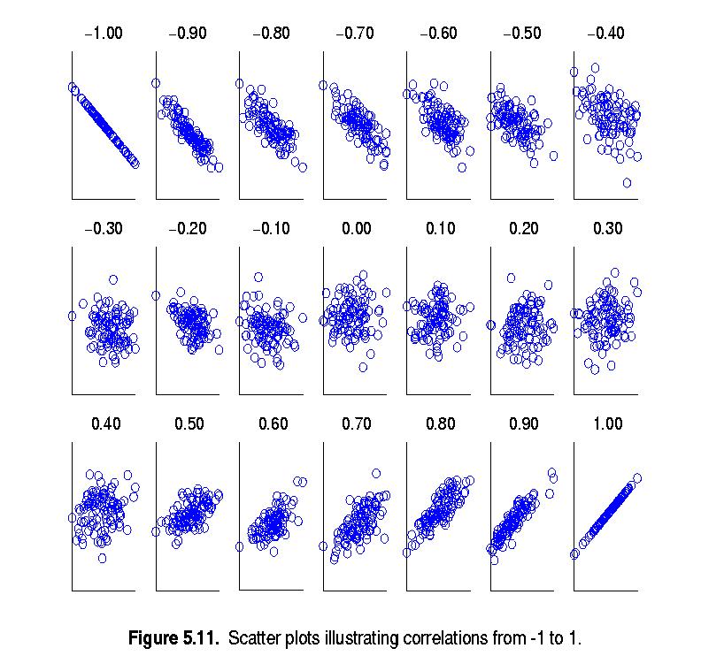
Visually Evaluating Correlation
Scatter plots showing the similarity from –1 to 1.
Source: “Introduction to Data Mining” by Vipin Kumar et al

Slide 18
Does anyone know know the difference between Pearson and Spearman correlation?

Slide 19
Partitioning Algorithms: Basic Concept
Partitioning method: Construct a partition of a database D of n objects into a set of k clusters
Given a k, find a partition of k clusters that optimizes the chosen partitioning criterion
Global optimal: exhaustively enumerate all partitions
Heuristic methods: k-means and k-medoids algorithms
k-means : Each cluster is represented by the center of the cluster
k-medoids or PAM (Partition around medoids): Each cluster is represented by one of the objects in the cluster

Slide 20
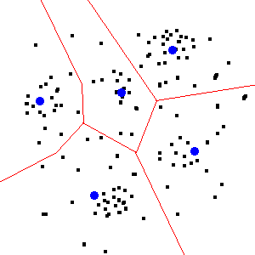
The K-Means Clustering
Given k, the k-means algorithm is as follows:
Choose k cluster centers to coincide with k randomly-chosen points
Assign each data point to the closest cluster center
Recompute the cluster centers using the current cluster memberships.
If a convergence criterion is not met, go to 2).
Typical convergence criteria are: no (or minimal) reassignment of data points to new cluster centers, or minimal decrease in squared error.
p is a point and m_{i} is the mean of cluster C_{i}

Slide 21
Comments on K-Means
Strength: efficient: O(tkn), where n is # data points, k is # clusters, and t is # iterations. Normally, k, t << n.
Comment: Often terminates at a local optimum. The global optimum may be found using techniques such as: deterministic annealing and genetic algorithms
Weakness
Applicable only when mean is defined, difficult for categorical data
Need to specify k, the number of clusters, in advance
Sensitive to noisy data and outliers
Not suitable to discover clusters with non-convex shapes
Sensitive to initial seeds

Slide 22
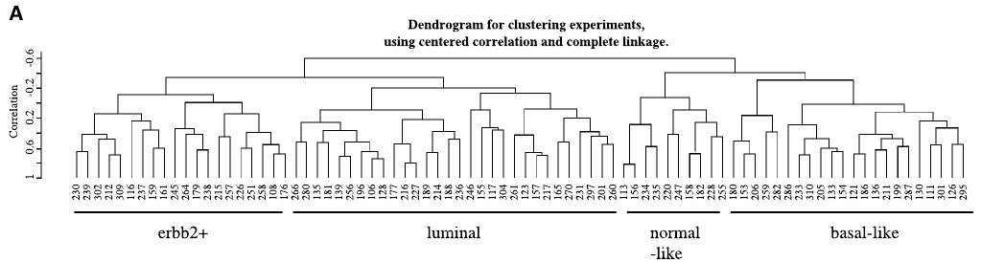
Hierarchical methods
A hierarchical method: construct a of clustering is hierarchy of clustering, not just a single partition of objects
The number of clusters k is not required as an input
Use a distance matrix as clustering criteria
A termination condition can be used (e.g., a number of clusters)
The hierarchy often given as a clustering tree, also called a dendrogram
leaves of the tree represent the individual objects
internal nodes of the tree represent the clusters

Slide 23
Two types of hierarchical methods
Two main types of hierarchical clustering techniques:
agglomerative (bottom-up):
place each object in its own cluster (a singleton)
merge in each step the two most similar clusters until there is only one cluster left or the termination condition is satisfied
divisive (top-down):
start with one big cluster containing all the objects
divide the most distinctive cluster into smaller clusters and proceed until there are n clusters or the termination condition is satisfied
Notes:
The approach in words:
Start with each point in its own cluster.
Identify the closest two clusters and merge them.
Repeat.
Ends when all points are in a single cluster.

Slide 24
Two types of hierarchical methods
Step 0
Step 1
Step 2
Step 3
Step 4
agglomerative
a
a b
b
a b c d e
c
c d e
d
d e
e
divisive
Step 4
Step 3
Step 2
Step 1
Step 0

Slide 25
Inter-cluster distances
Three widely used ways of defining the inter-cluster distance, i.e., the distance between two separate clusters, are
single linkage method (nearest neighbour):
complete linkage method (furthest neighbour):
average linkage method (unweighted pair-group average):

Slide 26
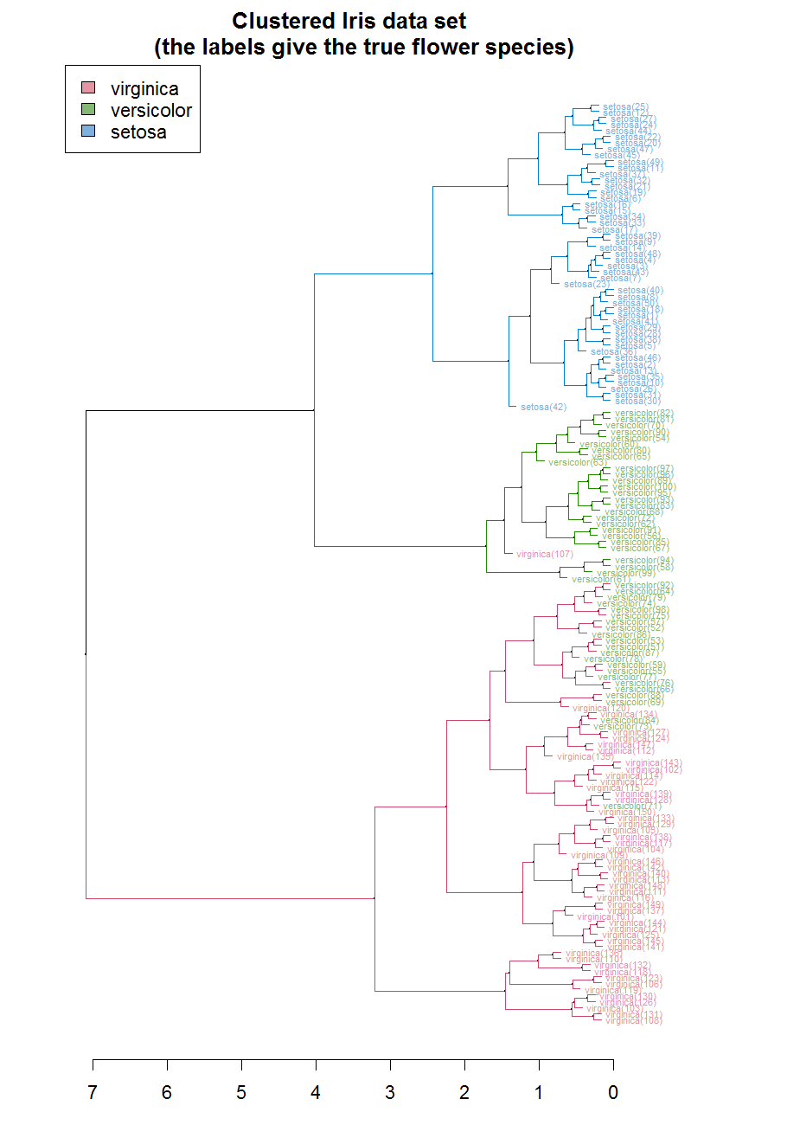
Strengths of hierarchical methods
Conceptually simple
Theoretical properties are well understood
When clusters are merged/split, the decision is permanent => the number of different alternatives that need to be examined is reduced

Slide 27
If you could only choose between K-means and Hierarchical methods, which would you choose, and why?

Slide 28
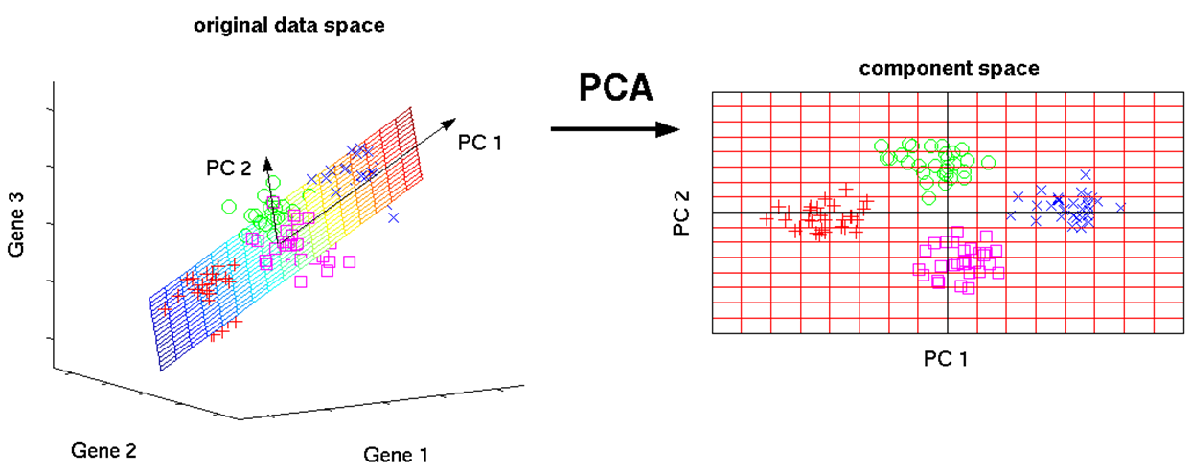
Principle component analysis
There will be a whole module on this topic
Essentially, the goal is to identify the axes where the majority of the variance in the data is located and represent the data on those axes
Principle components are the eigenvectors of the dataset

Slide 29
Properties of PCA
Weaknesses
Limited to linear projections
Not scale invariant

Slide 30
Challenges of non-linear data structures

Slide 31
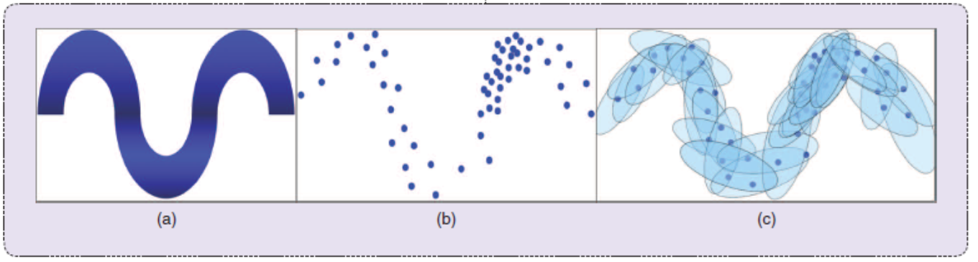
Stochastic neighbor embedding
Stochastic Neighbor Embedding (SNE) starts by converting the high-dimensional Euclidean distances between datapoints into conditional probabilities that represent similarities using a Gaussian distribution.
For the low-dimensional counterparts to high-dimensional datapoints, it is possible to compute a similar conditional probability.
A cost function then finds the samples that are “close”.

Slide 32
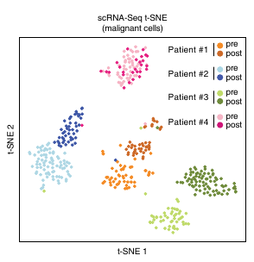
t-SNE: t-distributed stochastic neighbor embedding
A student-t distribution rather than a Gaussian to compute the similarity between two points in the low-dimensional space.
t-SNE employs a heavy-tailed distribution in the low-dimensional space to alleviate both the crowding problem and the optimization problems
Goal of t-SNE – preserve the higher order structure in the low dimensional space.

Slide 33
Summary
Unsupervised learning methods can provide a method to evaluate complex datasets
As a stand-alone tool to get insight into data distribution
As a preprocessing step for other algorithms
We highlighted a few Distance metrics & Clustering Algorithms.
k-Means clustering.
Hierarchical Clustering.
Principal Components Analysis
t-SNE

